Slide 1
JAVA Lecture 3
Constructors, “this” keyword, Scanner, Garbage Collection

Slide 2




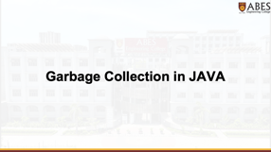




Slide 3
Constructors in JAVA

Slide 4
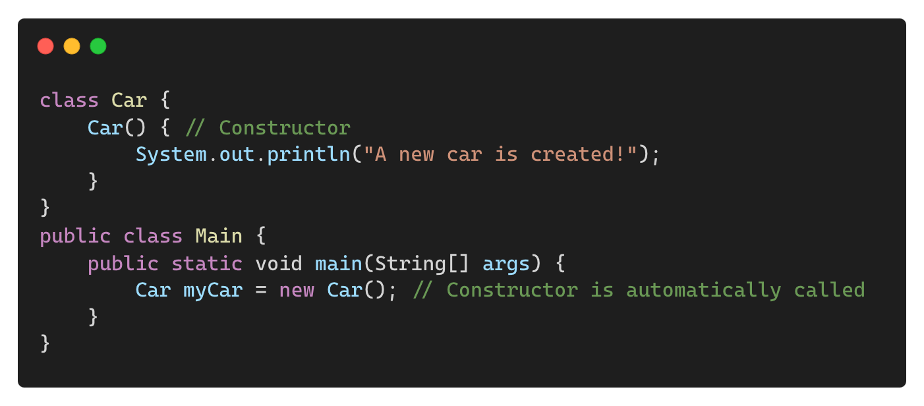
What is a Constructor?
A special method that initializes an object when it is created.
It has the same name as the class and no return type.
Output:
A new car is created!

Slide 5
Characteristics of a Constructor
Same name as the class
No return type (not even void)
Automatically invoked when an object is created
Can have parameters (parameterized constructor)
If no constructor is defined, Java provides a default constructor

Slide 6
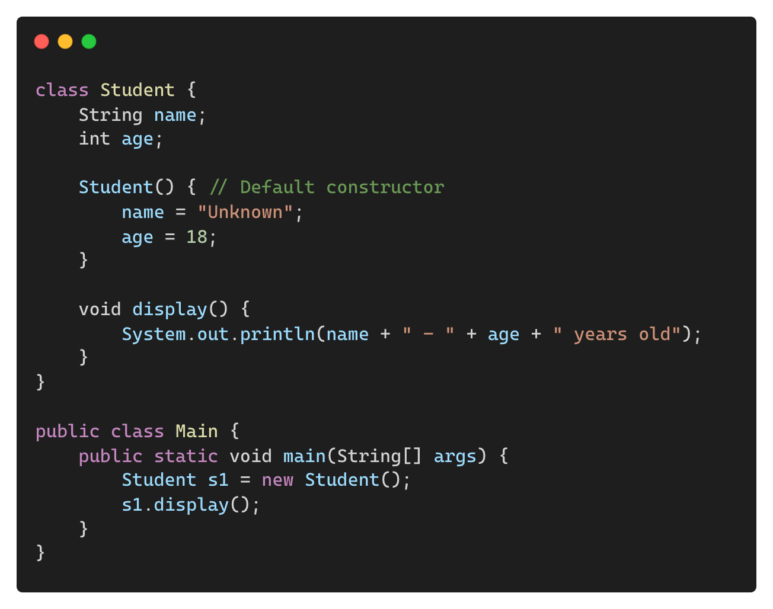
Default Constructor
A constructor without parameters that assigns default values.
Output:
Unknown - 18 years old

Slide 7
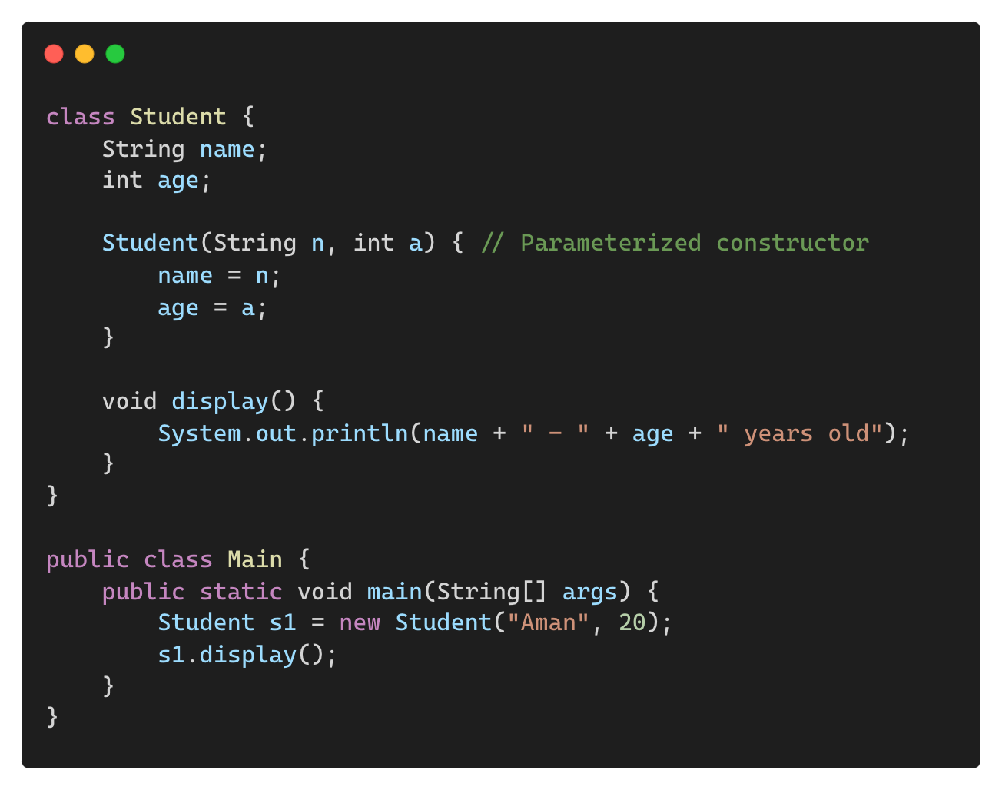
Parameterized Constructor
Allows passing values during object creation.
Output:
Aman - 20 years old

Slide 8
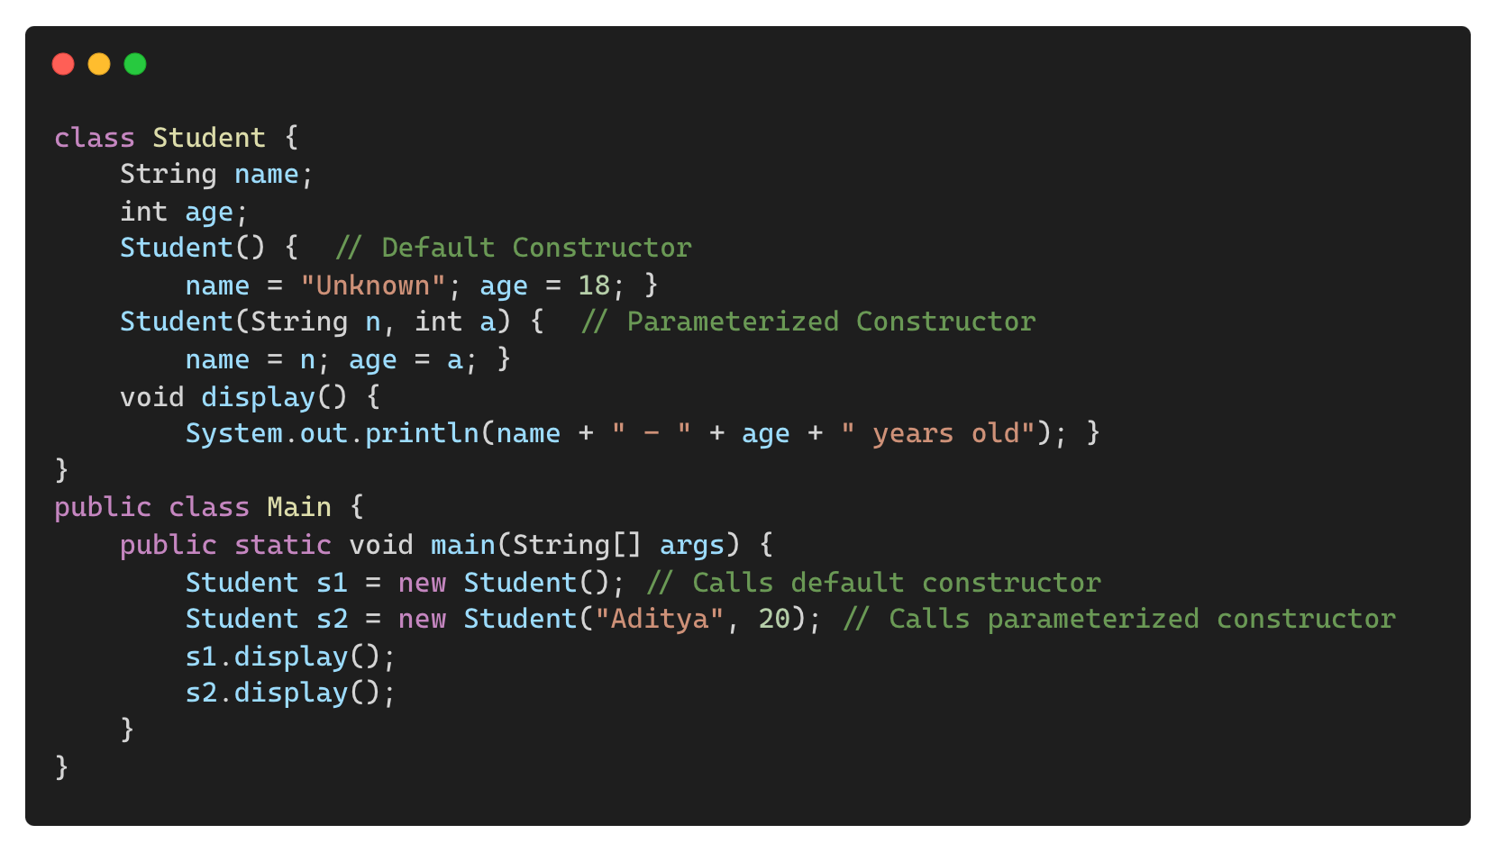
Constructor Overloading
Multiple constructors with different parameters.
Output:
Unknown - 18 years old
Aditya - 20 years old

Slide 9
Difference Between Constructor and Method
Feature | Constructor | Method
Name | Same as class name | Any valid identifier
Return Type | No return type | Has return type (void, int, etc.)
Invocation | Called automatically when object is created | Called explicitly
Purpose | Initializes an object | Performs an operation

Slide 10
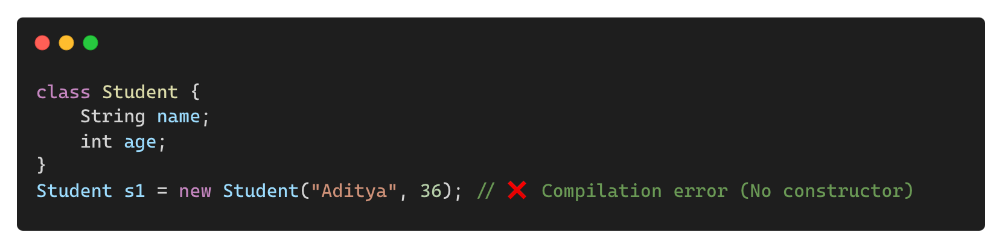
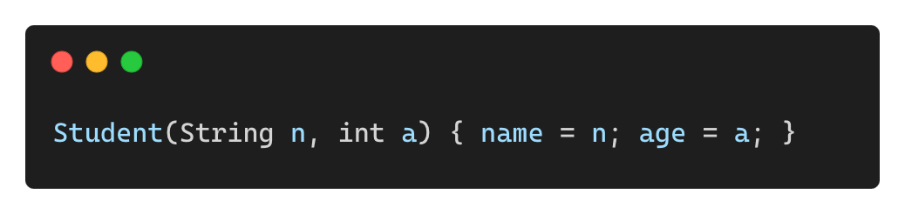
Common Mistakes with Constructors
❌ Forgetting to Define a Constructor When Needed
✅ Solution: Define a constructor explicitly.

Slide 11
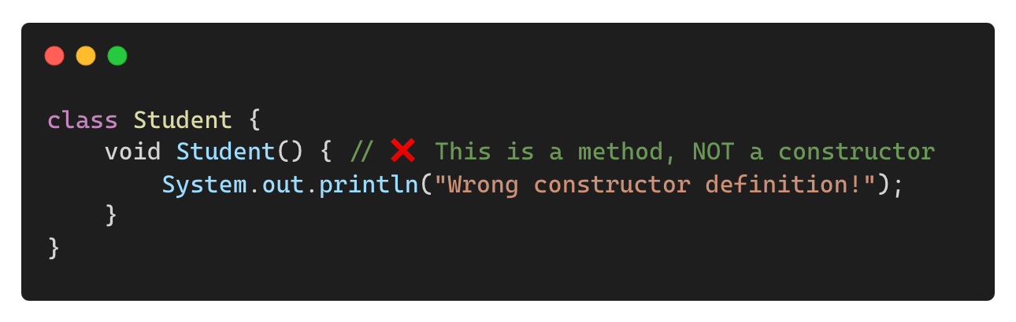
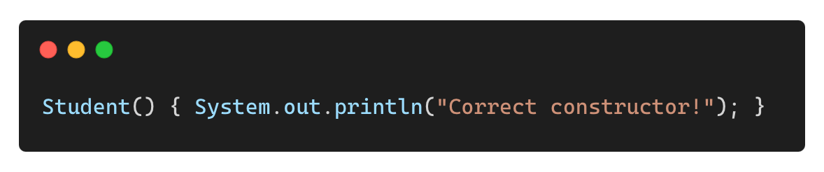
Common Mistakes with Constructors
❌ Using a Return Type in a Constructor
✅ Solution: Remove return type.

Slide 12
“this” keyword in JAVA

Slide 13
“this” keyword
The this keyword is a reference variable that refers to the current object in Java.
Used to avoid confusion between instance and local variables with the same name.
Helps in constructor chaining and returning the current object.

Slide 14
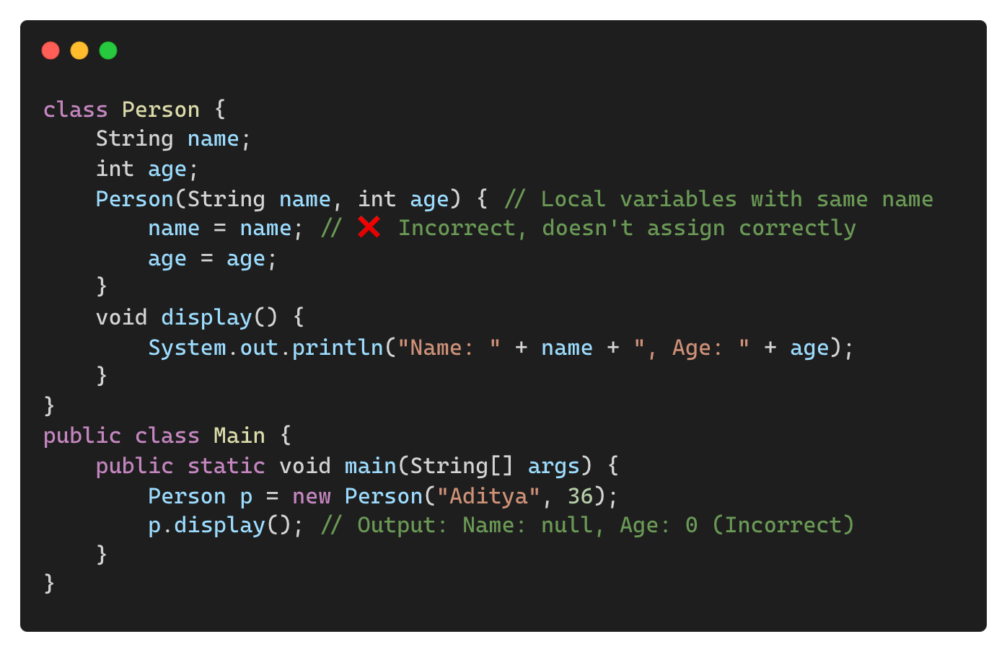
Using “this” to Refer to Instance Variables
Without this (Variable Shadowing Issue):

Slide 15
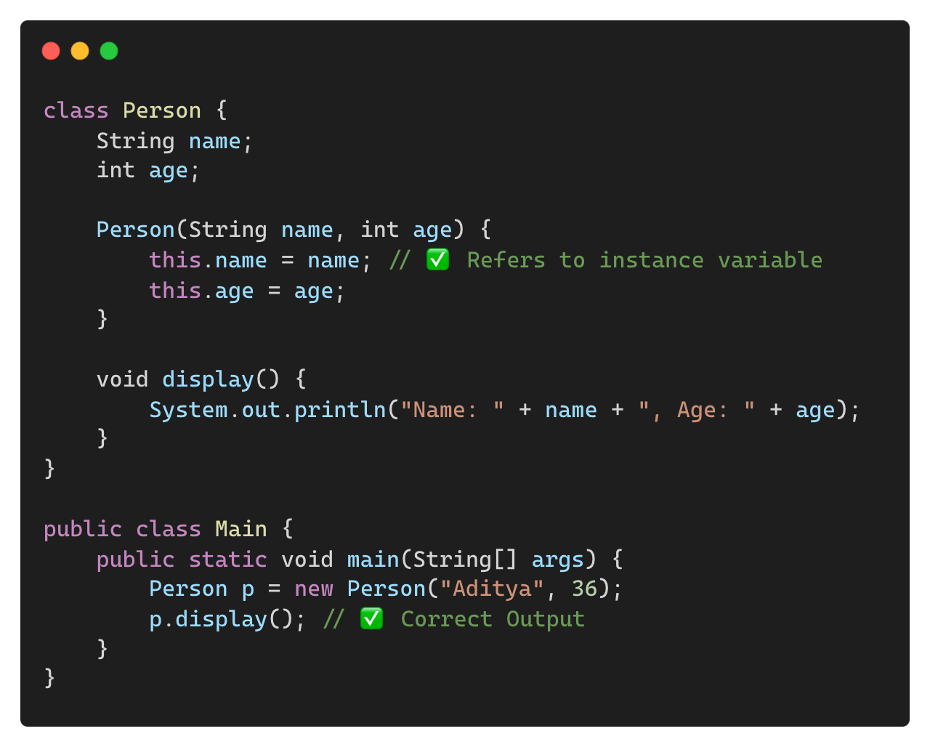
Using “this” to Refer to Instance Variables (Contd.)
Correct Way (Using this):
Output:
Name: Aditya, Age: 36

Slide 16
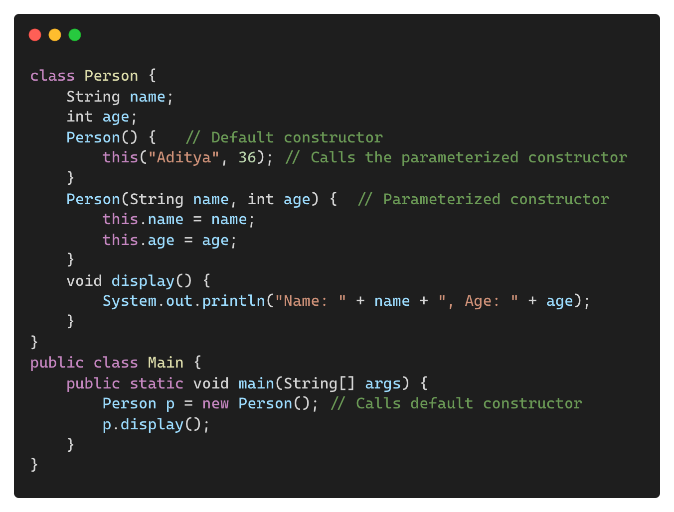
Using “this” to Call a Constructor
A constructor can call another constructor using this().
Example (Constructor Chaining):
Output:
Name: Aditya, Age: 36

Slide 17
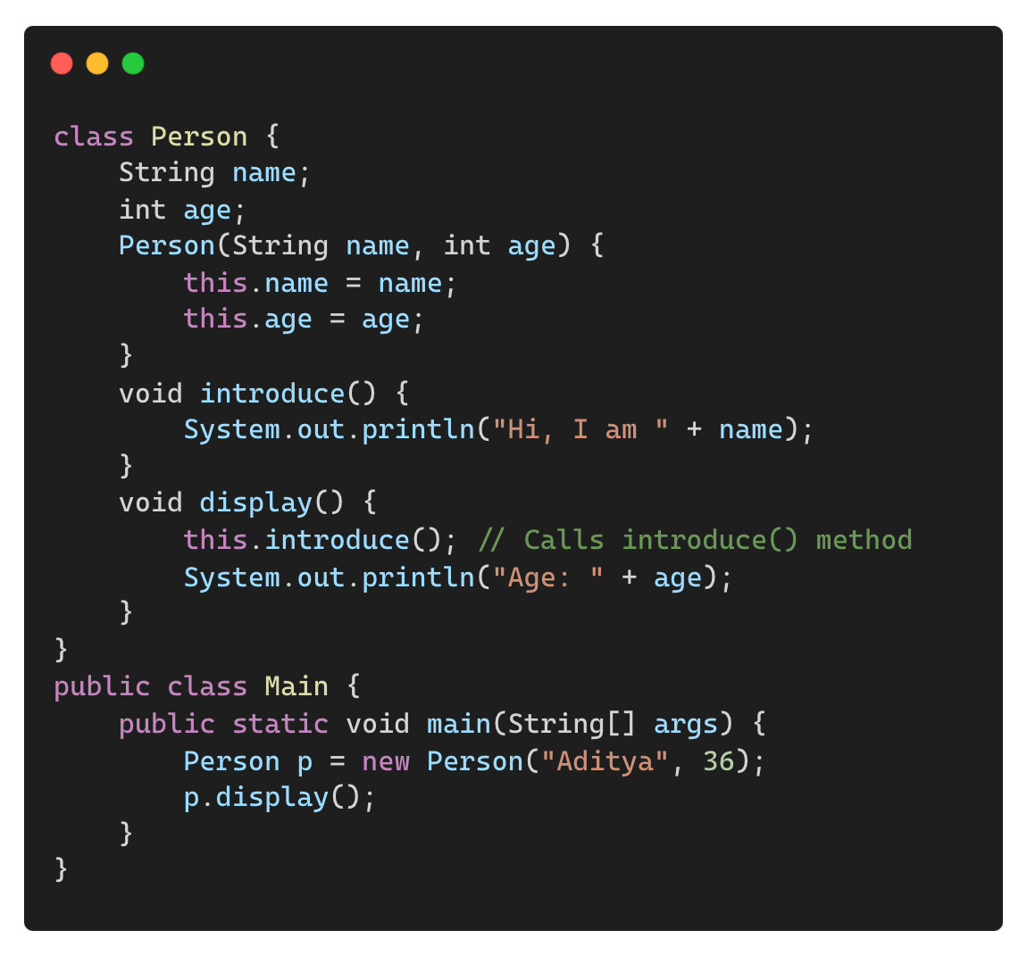
Using “this” to Call a Method
You can use this to call another method within the same class.
Output:
Hi, I am Aditya
Age: 36

Slide 18
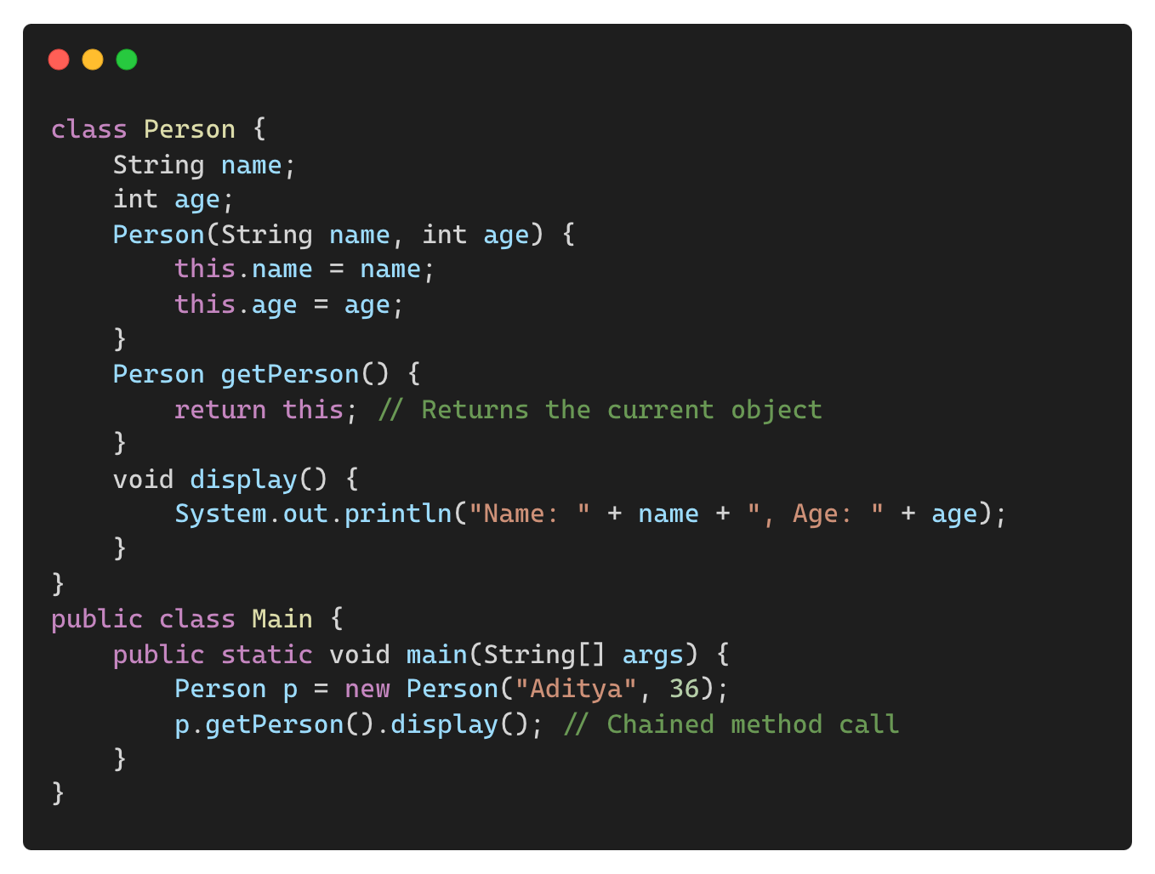
Returning Current Object Using “this”
Output:
Name: Aditya, Age: 36

Slide 19
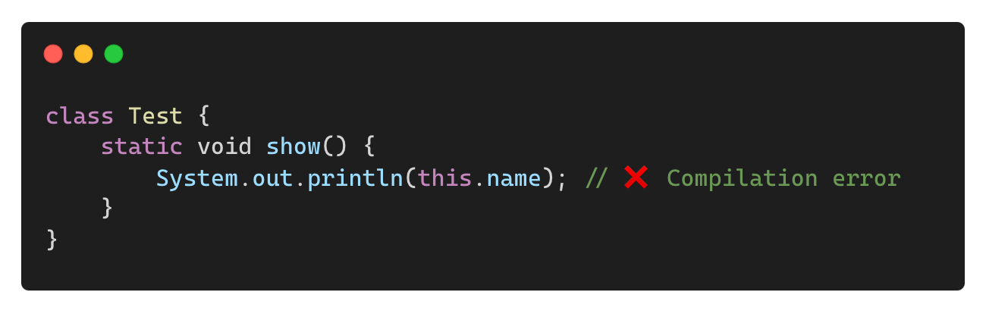
Common Mistakes When Using “this”
❌ Using this in a Static Context
✅ Solution:
• this cannot be used in static methods because it refers to an instance.

Slide 20
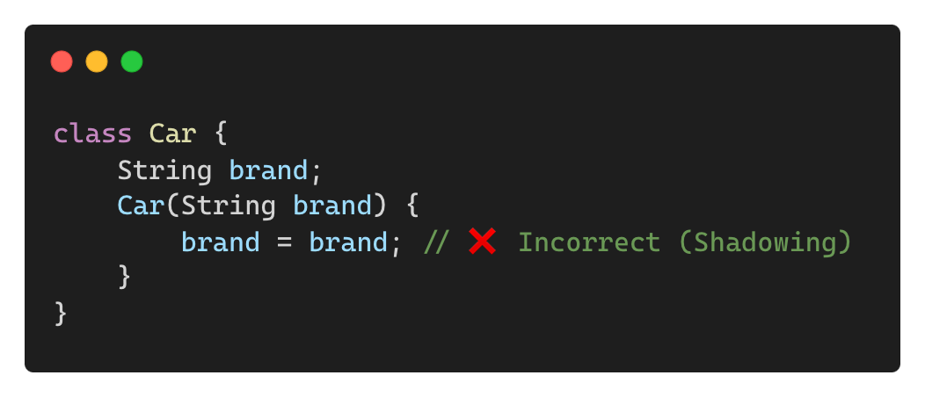
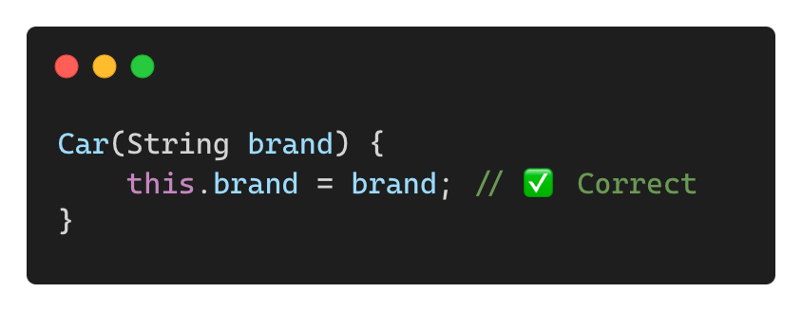
Common Mistakes When Using “this” (Contd.)
❌ Forgetting to Use this When Required
✅ Solution:

Slide 21
When to Use “this” in Java
To resolve variable shadowing when local and instance variables have the same name.
To call another constructor in the same class (this()).
To invoke another method within the same class (this.methodName()).
To return the current object (return this;) in method chaining.

Slide 22
Scanner Class

Slide 23
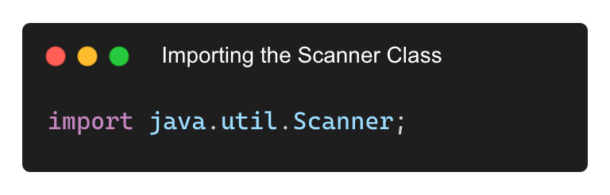
What is the Scanner Class?
• Scanner is a built-in class in Java used to take user input from the keyboard.
• Part of the java.util package.
• Reads input as strings, integers, floats, etc.

Slide 24
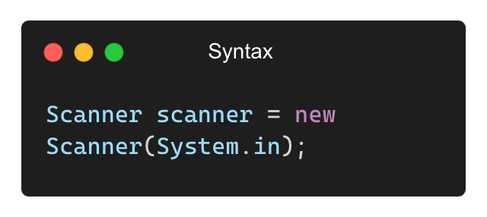
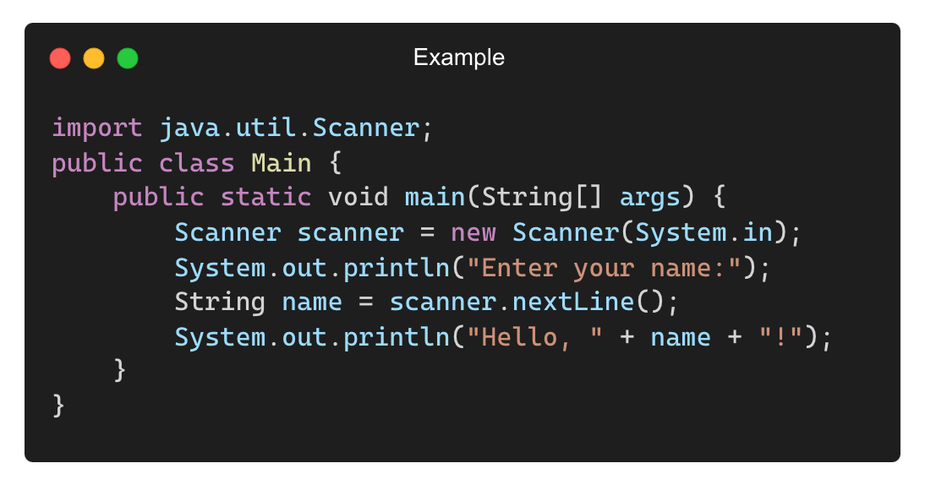
Creating a Scanner Object
Input: Aditya
Output: Hello, Aditya!

Slide 25
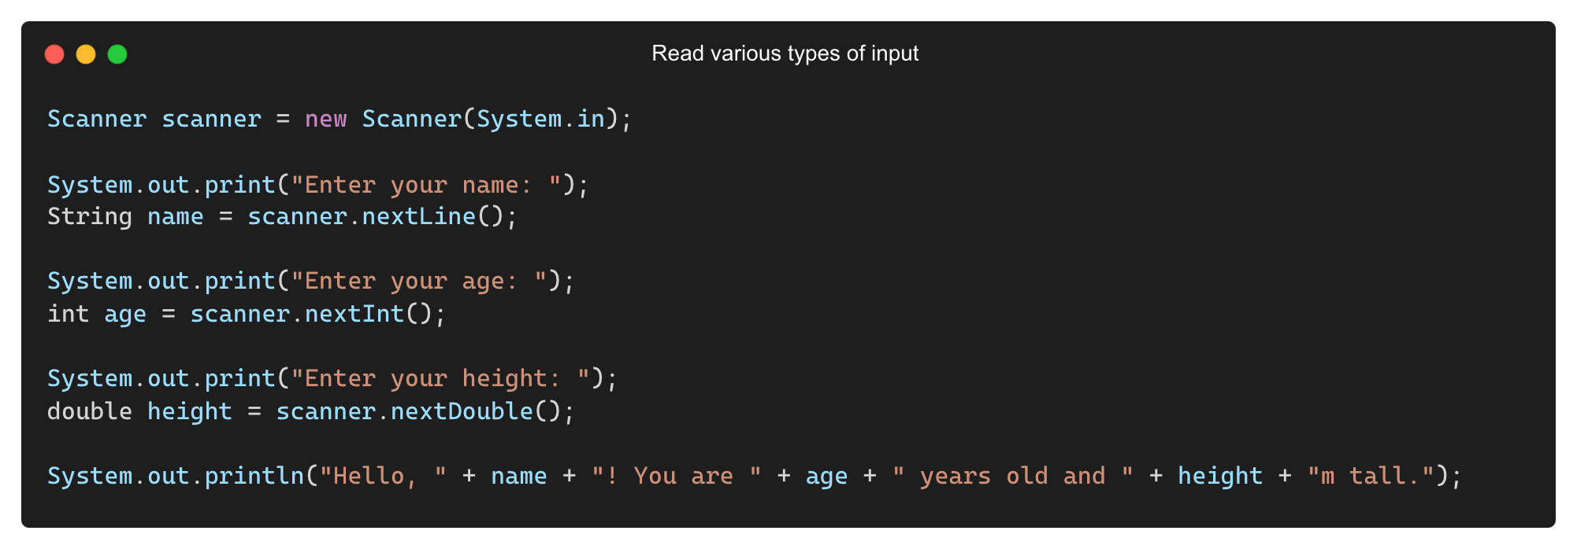
Reading Different Data Types
Sample input:
Aditya
36
1.75
Output:
Hello, Aditya! You are 36 years old and 1.75m tall

Slide 26
Common Methods of the Scanner Class
Method | Description | Example
nextLine() | Reads a full line of text | String name = scanner.nextLine();
next() | Reads a single word | String word = scanner.next();
nextInt() | Reads an integer | int age = scanner.nextInt();
nextDouble() | Reads a decimal number | double height = scanner.nextDouble();
nextBoolean() | Reads true or false | Boolean isAdult = scanner.nextBoolean();

Slide 27
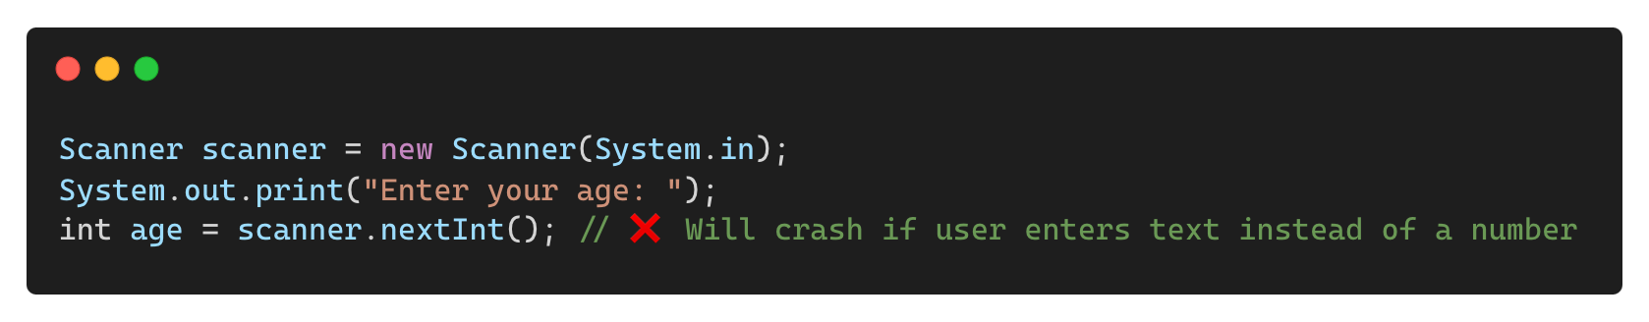
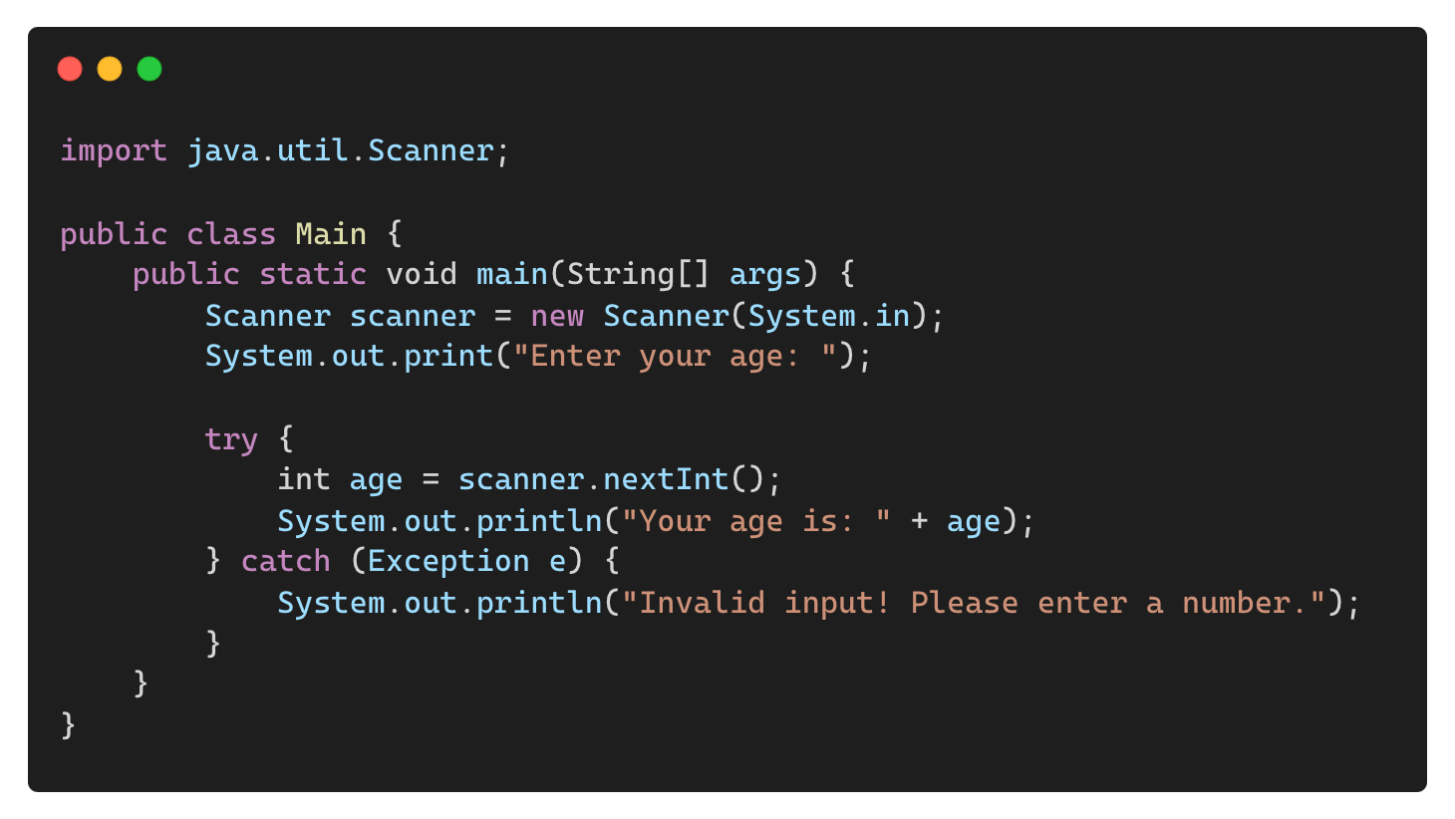
Handling Input Errors (Avoiding Exceptions)
Incorrect Input Type (InputMismatchException)
Solution: Use try-catch to Handle Exceptions

Slide 28
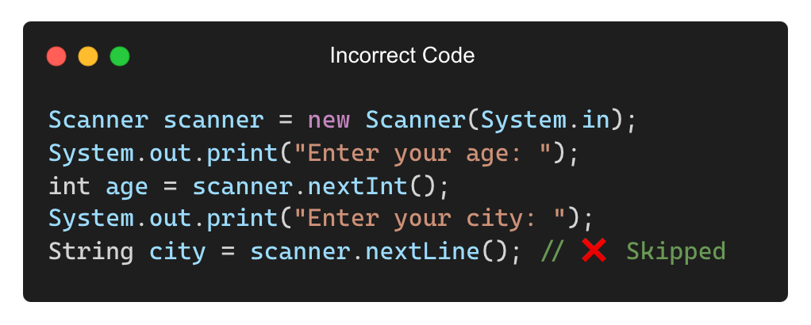
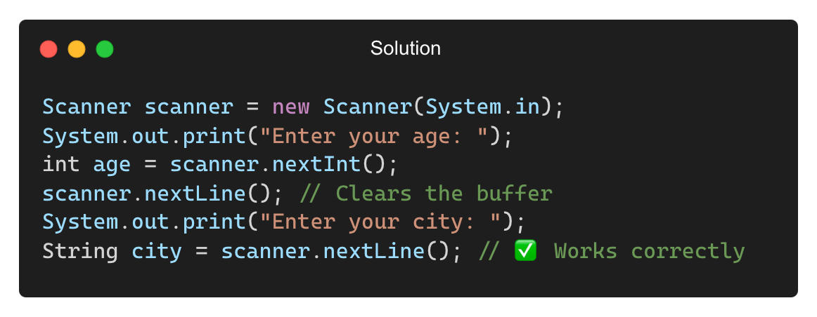
Flushing the Scanner Buffer (Avoiding Skipping Issues)
Problem: Using nextLine() after nextInt() or nextDouble() causes skipping of input.
Solution: Use scanner.nextLine() after nextInt() to clear the buffer.
Correct Output:
Enter your age: 36
Enter your city: Ghaziabad

Slide 29
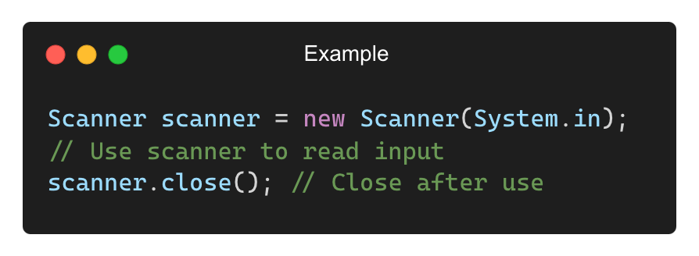
Closing the Scanner Object
Importance: Prevents resource tasks when not using System.in anymore.
Note: Do not close Scanner if using System.in multiple times in the same program.

Slide 30
Garbage Collection in JAVA

Slide 31
What is Garbage Collection in Java?
Garbage collection (GC) is the automatic process of deallocating memory occupied by unreferenced objects.
Java does not require manual memory management (like C/C++).
The JVM’s Garbage Collector (GC) reclaims memory when objects are no longer in use.
Why is it needed?
Prevents memory leaks
Improves memory efficiency
Reduces manual effort in memory management

Slide 32
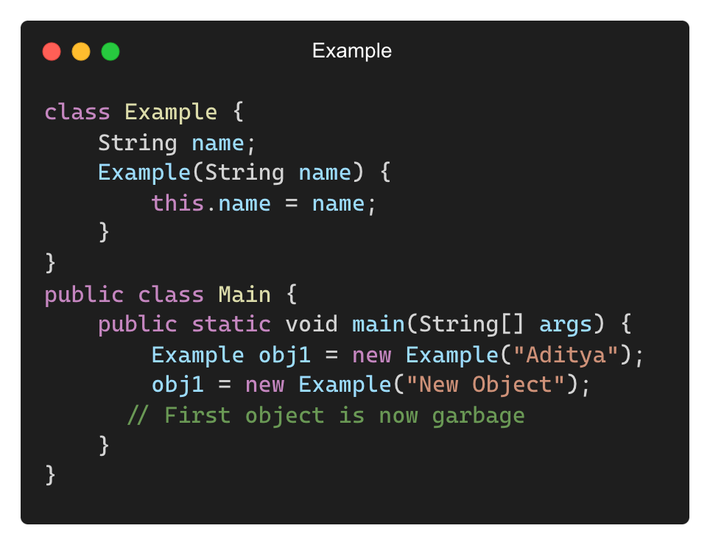
How Does Garbage Collection Work?
Process:
Object Created → Stored in Heap Memory
Object Used → Referenced by a variable
Object Becomes Unused → No active reference
Garbage Collector Reclaims Memory
The first "Aditya" object is now unreferenced and eligible for garbage collection.

Slide 33
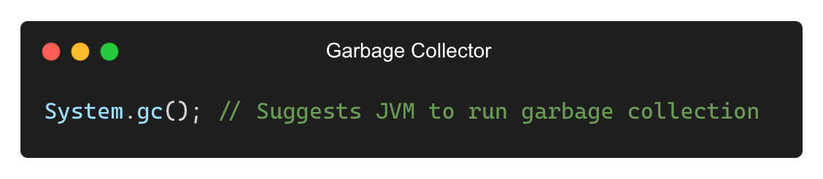
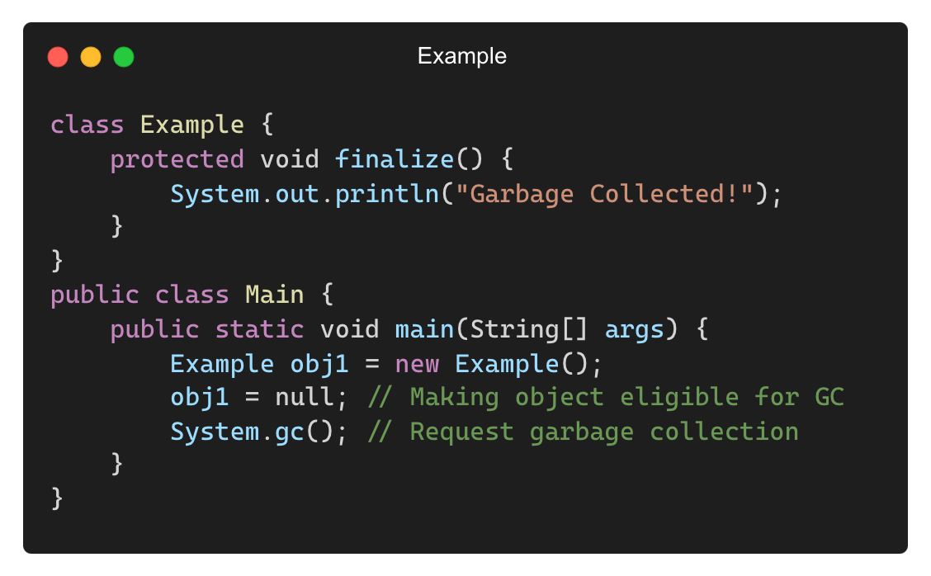
Explicitly Requesting Garbage Collection
The Garbage Collector runs automatically, but we can request it manually using:
Output (May Vary):
Garbage Collected!

Slide 34
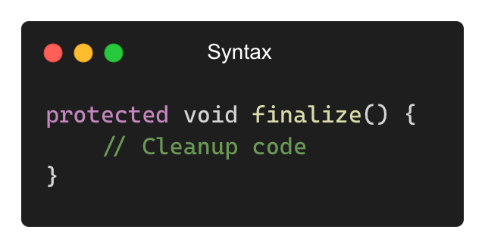
The finalize() Method
finalize() is a special method in Java called by the Garbage Collector before an object is removed.
Used for cleanup tasks like closing files, releasing resources, etc.

Slide 35
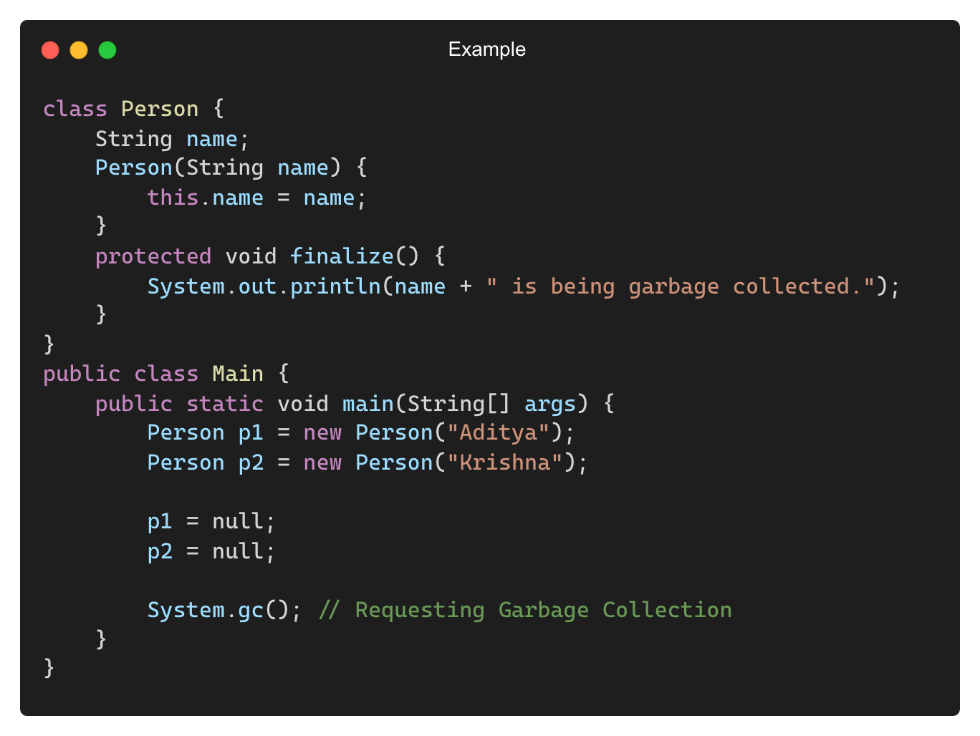
Example of finalize() Method

Slide 36
When Does Java Run Garbage Collection?
Low memory situations
JVM decides based on object reachability
When calling System.gc() (suggestion only, not guaranteed)
Java uses different algorithms for garbage collection:
Mark and Sweep → Marks unused objects and removes them
Generational Garbage Collection → Categorizes objects based on their lifecycle

Slide 37
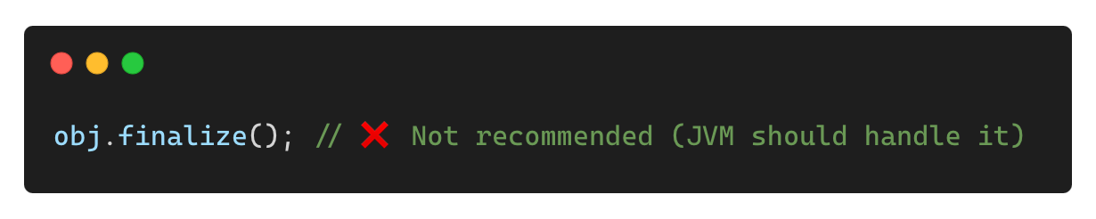
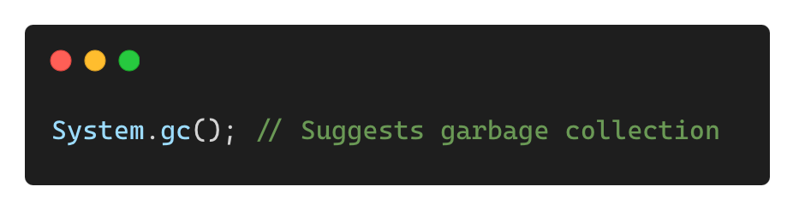
Common Mistakes with Garbage Collection
❌ Manually Calling finalize()
✅ Let JVM Handle It:
❌ Assuming System.gc() Always Runs GC
• It only suggests GC, but does not guarantee execution.
• JVM decides when to collect garbage.

Slide 38
THANK YOU

